Slide 1
MACHINE LEARNING
MA124 Project specifications
University of Warwick

Slide 2
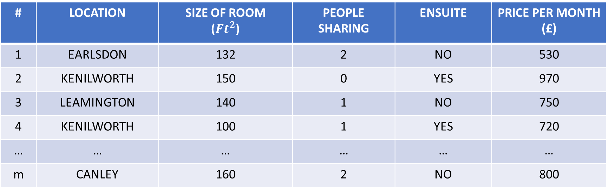
How to predict rent prices?
# | LOCATION | SIZE OF ROOM ($Ft^{2}$) | PEOPLE SHARING | ENSUITE | PRICE PER MONTH (£)
1 | EARLSDON | 132 | 2 | NO | 530
2 | KENILWORTH | 150 | 0 | YES | 970
3 | LEAMINGTON | 140 | 1 | NO | 750
4 | KENILWORTH | 100 | 1 | YES | 720
… | … | … | … | … | …
m | CANLEY | 160 | 2 | NO | 800

Slide 3

How to predict rent prices?
# | LOCATION | SIZE OF ROOM ($Ft^{2}$) | PEOPLE SHARING | ENSUITE | PRICE PER MONTH (£)
1 | EARLSDON | 132 | 2 | NO | 530
2 | KENILWORTH | 150 | 0 | YES | 970
3 | LEAMINGTON | 140 | 1 | NO | 750
4 | KENILWORTH | 100 | 1 | YES | 720
… | … | … | … | … | …
m | CANLEY | 160 | 2 | NO | 800
$$x_{0}$$

Slide 4



How to predict rent prices?
# | LOCATION | SIZE OF ROOM ($Ft^{2}$) | PEOPLE SHARING | ENSUITE | PRICE PER MONTH (£)
1 | EARLSDON | 132 | 2 | NO | 530
2 | KENILWORTH | 150 | 0 | YES | 970
3 | LEAMINGTON | 140 | 1 | NO | 750
4 | KENILWORTH | 100 | 1 | YES | 720
… | … | … | … | … | …
m | CANLEY | 160 | 2 | NO | 800
$$x_{0}$$
$$x_{1}$$
$$x_{2}$$
$$x_{3}$$
FEATURES

Slide 5

How to predict rent prices?
# | LOCATION | SIZE OF ROOM ($Ft^{2}$) | PEOPLE SHARING | ENSUITE | PRICE PER MONTH (£)
1 | EARLSDON | 132 | 2 | NO | 530
2 | KENILWORTH | 150 | 0 | YES | 970
3 | LEAMINGTON | 140 | 1 | NO | 750
4 | KENILWORTH | 100 | 1 | YES | 720
… | … | … | … | … | …
m | CANLEY | 160 | 2 | NO | 800
$$x_{0}$$
$$x_{1}$$
$$x_{2}$$
$$x_{3}$$
$$y$$
FEATURES
LABELS

Slide 6

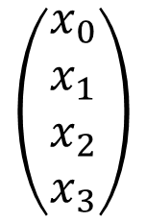
Function to learn
$$\left(\begin{aligned}x_{0} \\ x_{1} \\ x_{2} \\ x_{3}\end{aligned}\right)$$
Unknown function
$y$
GOAL: learn this function

Slide 7
Function to learn
$$\left(\begin{aligned}x_{0} \\ x_{1} \\ x_{2} \\ x_{3}\end{aligned}\right)$$
Unknown function
$y$
GOAL: learn this function
HOW?
Use the data you have collected to “train” your model to recognise patterns in the data.
Once model is trained, “test” it on new unseen data and try to predict rent of new houses.
REQUIRES: A LOT of data (10K, 100K, 1000K examples)

Slide 8
Types of learning
SUPERVISED LEARNING:
The model learns from being given “right answers” (labels).
Predict house rent/house price. (Regression problems)
Classify an image as “cat” or “dog”. (Classification problems)
…
UNSUPERVISED LEARNING:
The model does not have “right answers” (labels).
Generate new music.
Generate a new image.
Fly a helicopter.
…

Slide 9
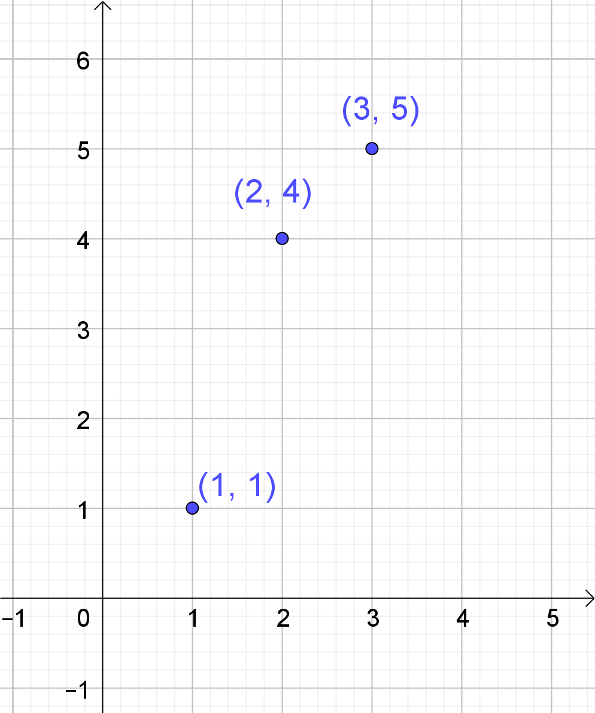

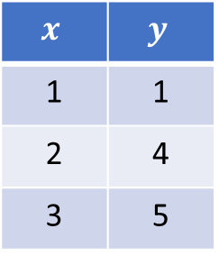





How does the model learn? TASK A2
3 points in the plane.
$$x$$ | $$y$$
1 | 1
2 | 4
3 | 5
$1$
$1$
$2$
$4$
$3$
$5$

Slide 10
How does the model learn? TASK A2
3 points in the plane.
$$x$$ | $$y$$
1 | 1
2 | 4
3 | 5
$1$
$1$
$2$
$4$
$3$
$5$
FEATURE
LABEL

Slide 11
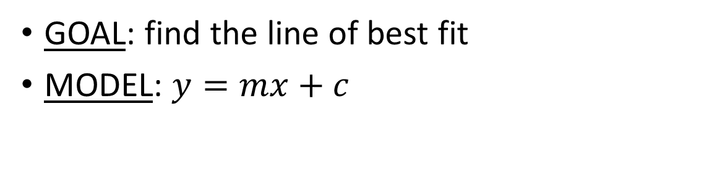
How does the model learn? TASK A2
3 points in the plane.
$$x$$ | $$y$$
1 | 1
2 | 4
3 | 5
$1$
$1$
$2$
$4$
$3$
$5$
FEATURE
LABEL
GOAL: find the line of best fit
MODEL: $y=mx+c$

Slide 12
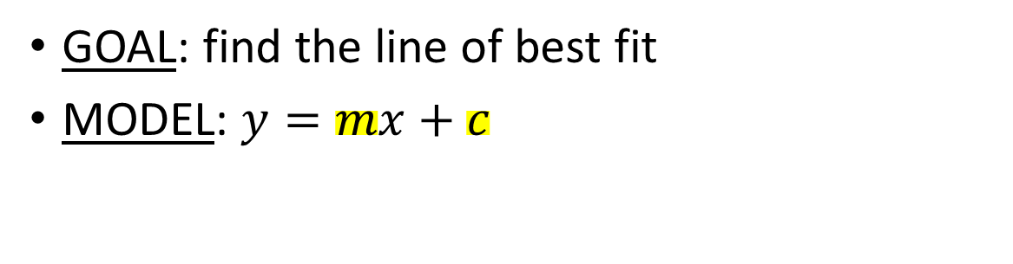
How does the model learn? TASK A2
3 points in the plane.
$$x$$ | $$y$$
1 | 1
2 | 4
3 | 5
$1$
$1$
$2$
$4$
$3$
$5$
FEATURE
LABEL
GOAL: find the line of best fit
MODEL: $y=mx+c$
PARAMETERS TO LEARN

Slide 13
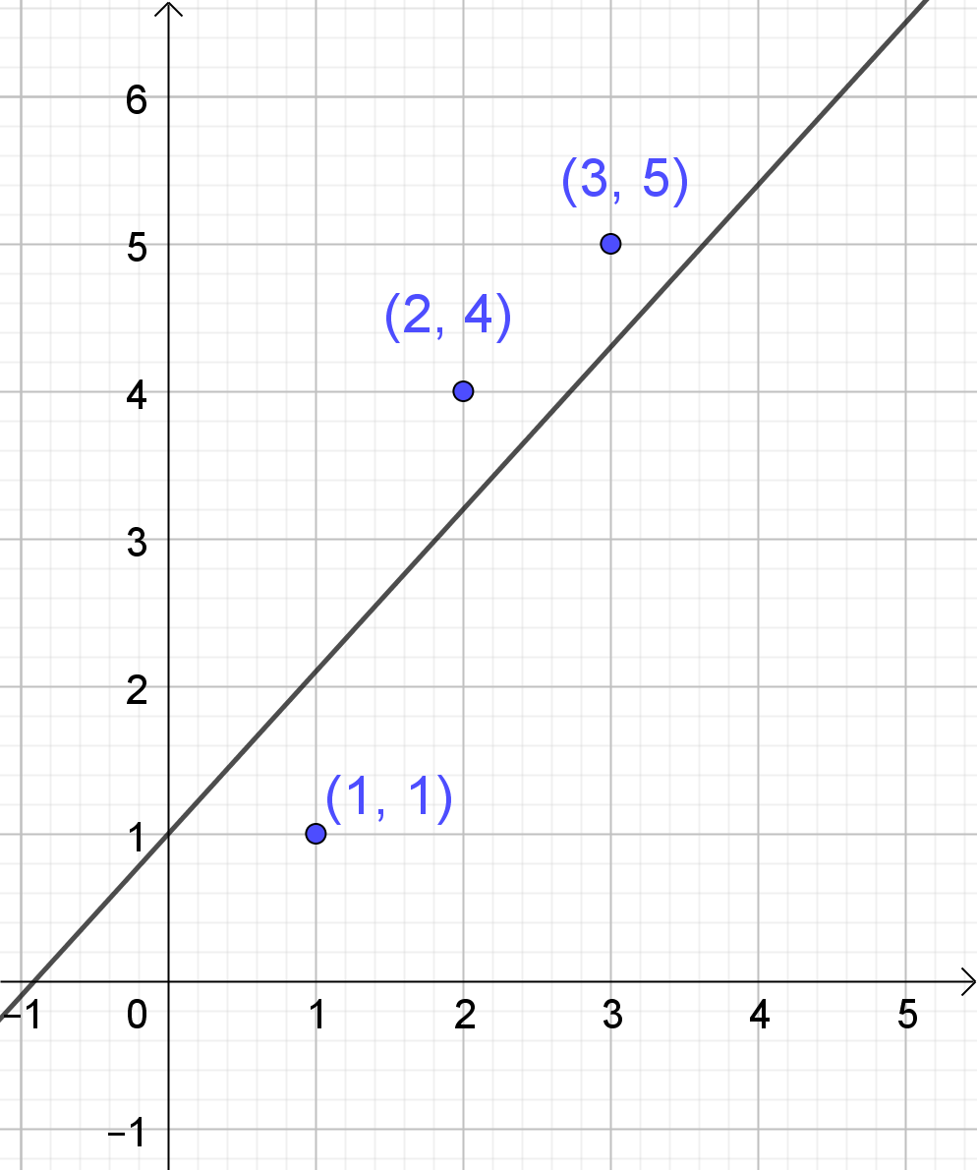
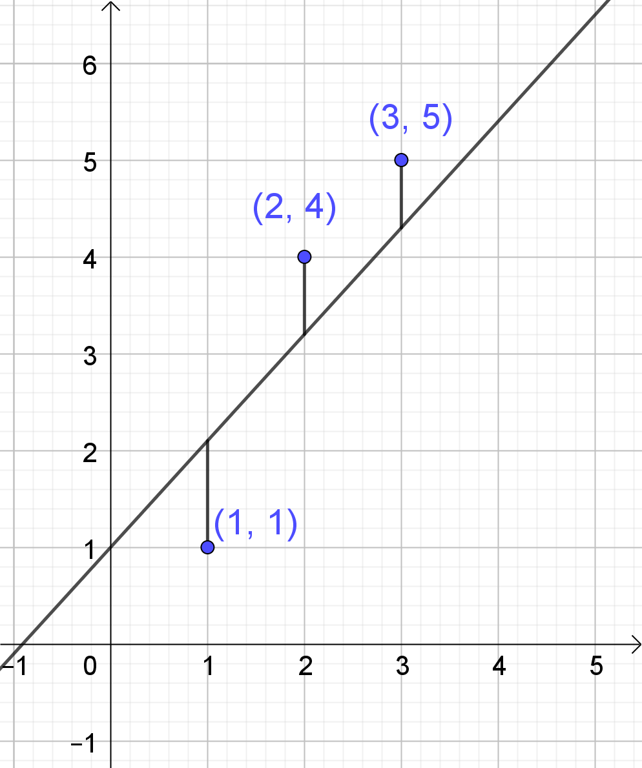

How does the model learn?
How does the model learn? TASK A2
Start with random values $m_{0}$ and $c_{0}$.
Initial predictions:
$$\hat{y}=m_{0}x+c_{0}$$

Slide 14
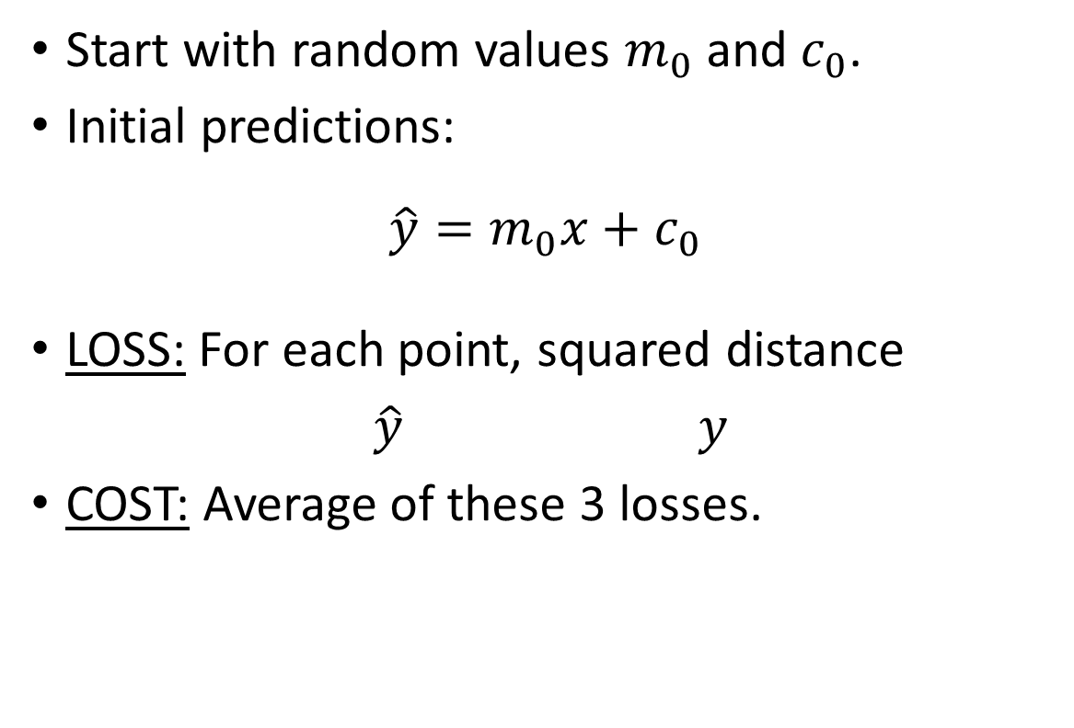
How does the model learn?
How does the model learn? TASK A2
Start with random values $m_{0}$ and $c_{0}$.
Initial predictions:
$$\hat{y}=m_{0}x+c_{0}$$
LOSS: For each point, squared distance
$\hat{y}$ $y$
COST: Average of these 3 losses.

Slide 15
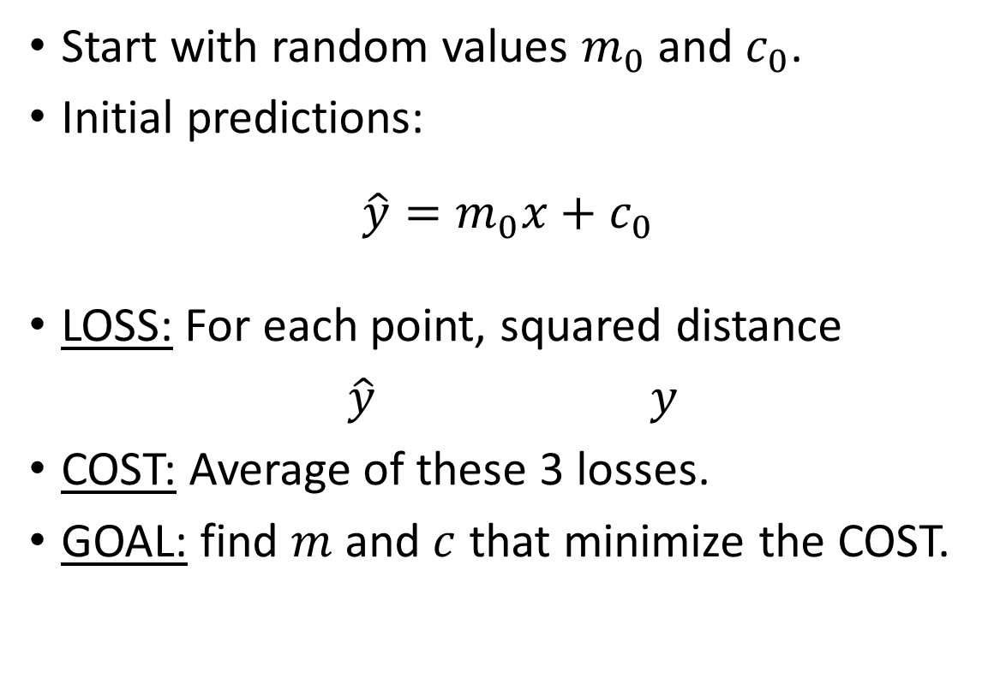
How does the model learn?
How does the model learn? TASK A2
Start with random values $m_{0}$ and $c_{0}$.
Initial predictions:
$$\hat{y}=m_{0}x+c_{0}$$
LOSS: For each point, squared distance
$\hat{y}$ $y$
COST: Average of these 3 losses.
GOAL: find $m$ and $c$ that minimize the COST.

Slide 16
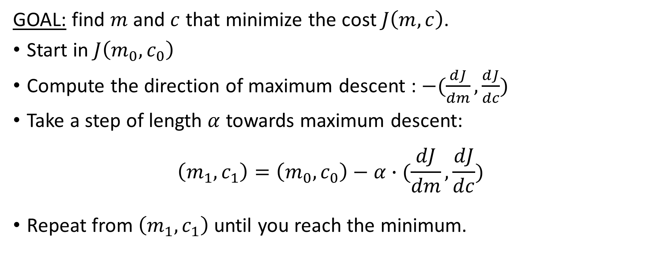
Optimization: Gradient descent.
GOAL: find $m$ and $c$ that minimize the cost $J\left(m,c\right)$.
Start in $J\left(m_{0},c_{0}\right)$
Compute the direction of maximum descent : $−(\frac{dJ}{dm},\frac{dJ}{dc})$
Take a step of length $α$ towards maximum descent:
$$\left(m_{1},c_{1}\right)=\left(m_{0},c_{0}\right)−α∙(\frac{dJ}{dm},\frac{dJ}{dc})$$
Repeat from $\left(m_{1},c_{1}\right)$ until you reach the minimum.

Slide 17
Binary classification: Cat or dog?
# | WEIGHT (Kg) | HEIGHT(cm) | 1 = Cat 0 = Dog
1 | 4.23 | 23 | 1
2 | 3.13 | 15 | 0
3 | 5.32 | 105 | 0
4 | 4.47 | 25 | 1
… | … | … | …
m | 5.31 | 110 | 0

Slide 18


Binary classification: Cat or dog?
# | WEIGHT (Kg) | HEIGHT(cm) | 1 = Cat 0 = Dog
1 | 4.23 | 23 | 1
2 | 3.13 | 15 | 0
3 | 5.32 | 105 | 0
4 | 4.47 | 25 | 1
… | … | … | …
m | 5.31 | 110 | 0
$$x_{0}$$
$$x_{1}$$
FEATURES

Slide 19

Binary classification: Cat or dog?
# | WEIGHT (Kg) | HEIGHT(cm) | 1 = Cat 0 = Dog
1 | 4.23 | 23 | 1
2 | 3.13 | 15 | 0
3 | 5.32 | 105 | 0
4 | 4.47 | 25 | 1
… | … | … | …
m | 5.31 | 110 | 0
$$x_{0}$$
$$x_{1}$$
$$y$$
FEATURES
LABELS

Slide 20

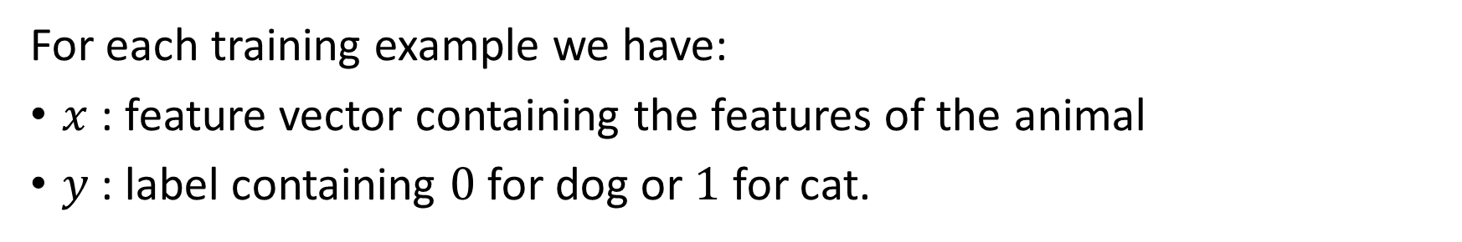
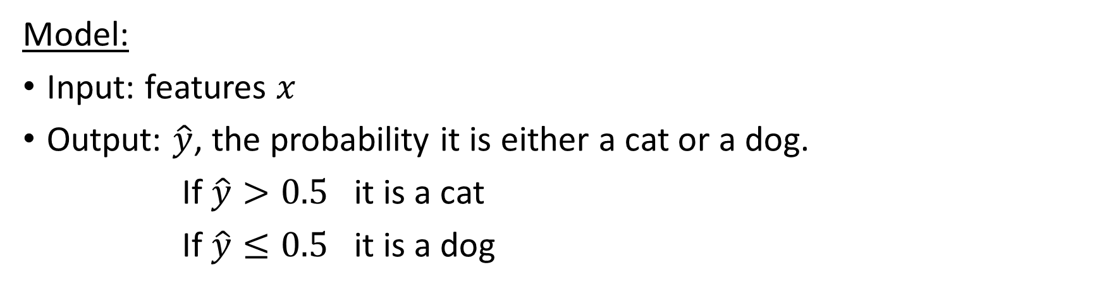
Binary classification
For each training example we have:
$x$: feature vector containing the features of the animal
$y$: label containing $0$ for dog or $1$ for cat.
$$x=\left(\begin{matrix}x_{0} \\ x_{1}\end{matrix}\right)$$
Model:
Input: features $x$
Output: $\hat{y}$, the probability it is either a cat or a dog.
If $\hat{y}>0.5$ it is a cat
If $\hat{y}≤0.5$ it is a dog

Slide 21


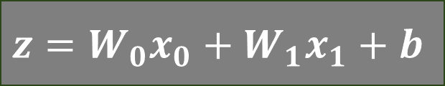
Logistic regression model
Input
$${ x}_{0}$$
Linear
$$z=W_{0}x_{0}+W_{1}x_{1}+b$$
$${ x}_{1}$$

Slide 22

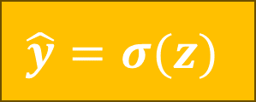
Logistic regression model
Input
$${ x}_{0}$$
Linear
Sigmoid
$$z=W_{0}x_{0}+W_{1}x_{1}+b$$
$$\hat{y}=σ(z)$$
$${ x}_{1}$$
$$σ\left(z\right)=\frac{1}{1+e^{−z}}$$

Slide 23




Logistic regression model
Output
Input
$$1$$
CAT
$${ x}_{0}$$
Linear
Sigmoid
$$>0.5$$
$$z=W_{0}x_{0}+W_{1}x_{1}+b$$
$$\hat{y}=σ(z)$$
$$≤0.5$$
$${ x}_{1}$$
$$σ\left(z\right)=\frac{1}{1+e^{−z}}$$
$$0$$
DOG

Slide 24
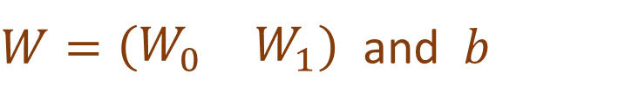
Logistic regression model
Output
Input
$$1$$
CAT
$${ x}_{0}$$
Linear
Sigmoid
$$>0.5$$
$$z=W_{0}x_{0}+W_{1}x_{1}+b$$
$$\hat{y}=σ(z)$$
$$≤0.5$$
$${ x}_{1}$$
PARAMETERS TO LEARN:
$$σ\left(z\right)=\frac{1}{1+e^{−z}}$$
$W=\left(\begin{matrix}W_{0} & W_{1}\end{matrix}\right)$ and $b$
$$0$$
DOG

Slide 25
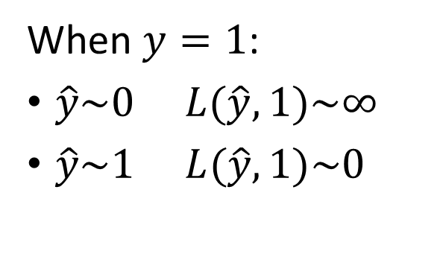
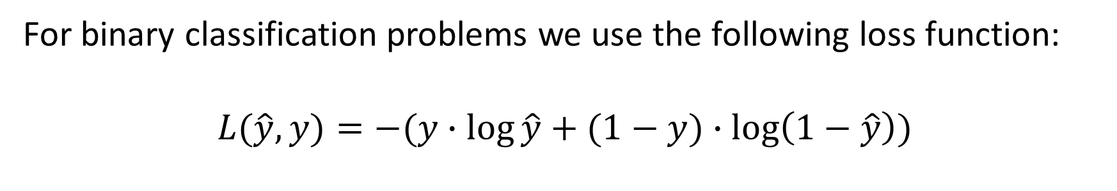
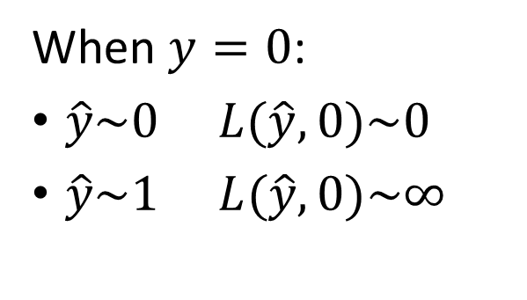
Binary Cross-entropy Loss
For binary classification problems we use the following loss function:
$$L(\hat{y}, y)=−(y∙\log{\hat{y}}+(1−y)∙\log\left(1−\hat{y}\right))$$
When $y=1$:
$\hat{y}\sim 0$ $L(\hat{y}, 1)\sim ∞$
$\hat{y}\sim 1$ $L(\hat{y}, 1)\sim 0$
When $y=0$:
$\hat{y}\sim 0$ $L(\hat{y}, 0)\sim 0$
$\hat{y}\sim 1$ $L(\hat{y}, 0)\sim ∞$

Slide 26
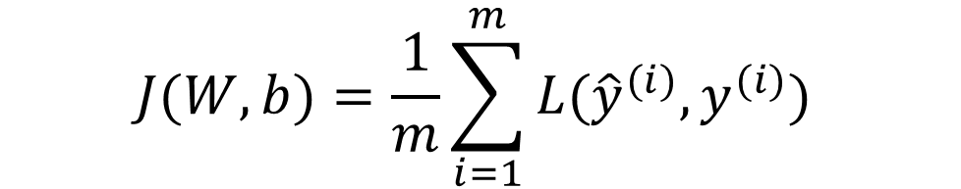


Cost function
For every training example $i=1, …,m$
$x^{(i)}$: Features vector.
$y^{(i)}$: Label
${\hat{y}}^{(i)}=σ(W∙x^{(i)}+b)$: Prediction of the model
COST : average of the losses on all training examples
$$J(W,b)=\frac{1}{m}\sum_{i=1}^{m}{L({\hat{y}}^{(i)}, y^{(i)}) }$$
$$\min_{W,b}{J(W,b)}$$
GOAL : find $W$ and $b$ that minimize the total cost.

Slide 27
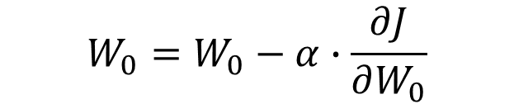


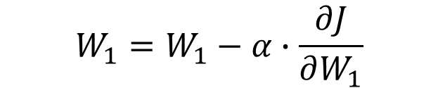
Optimization: Gradient descent
Step 0 : Initialize $W,b$ randomly.
Step 1 : Compute cost $J(W,b)$.
Step 2 : Compute derivatives of cost with respect to parameters $W,b$ .
Step 3 : Update parameters with a step $α$ towards minimum:
$$W_{0}=W_{0}−α∙\frac{∂J}{∂W_{0}}$$
$$b=b−α∙\frac{∂J}{∂b}$$
$$W_{1}=W_{1}−α∙\frac{∂J}{∂W_{1}}$$
Repeat steps 1 to 3 till you reach minimum.

Slide 28
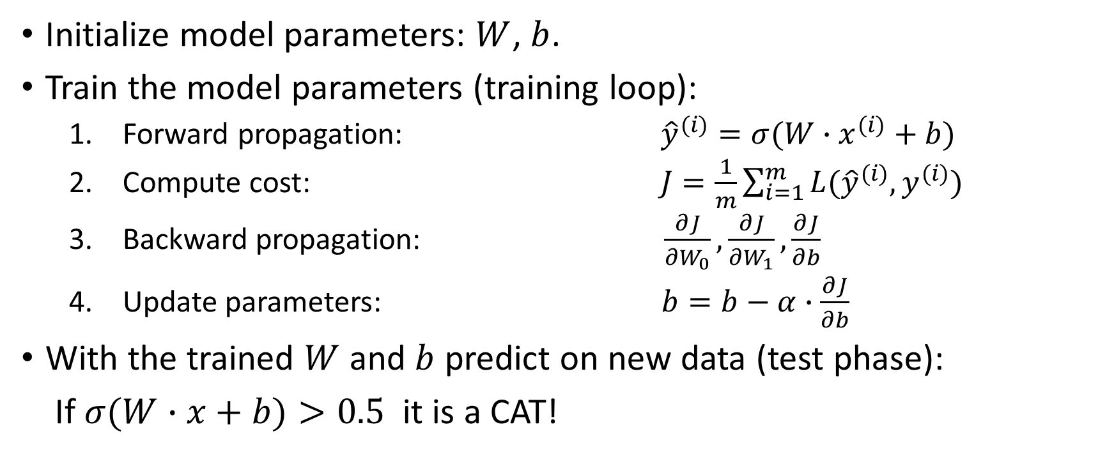
Logistic Regression Sum Up
Initialize model parameters: $W$, $b$.
Train the model parameters (training loop):
Forward propagation: ${\hat{y}}^{(i)}=σ(W∙x^{(i)}+b)$
Compute cost: $J=\frac{1}{m}\sum_{i=1}^{m}{L({\hat{y}}^{(i)}, y^{(i)}) }$
Backward propagation: $\frac{∂J}{∂W_{0}},\frac{∂J}{∂W_{1}},\frac{∂J}{∂b}$
Update parameters: $b=b−α∙\frac{∂J}{∂b}$
With the trained $W$ and $b$ predict on new data (test phase):
If $σ(W∙x+b)>0.5$ it is a CAT!

Slide 29







Neural Network model
Hidden layer
Input layer
$${ a}_{0}$$
$${ x}_{0}$$
Output layer
$${ a}_{1}$$
$\hat{y}$
$${ a}_{2}$$
$${ x}_{1}$$
$${ a}_{3}$$
Linear + Activation
Linear +
Activation

Slide 30

Neural Network forward propagation
$z=\left(\begin{matrix}z_{0} \\ \begin{aligned}z_{1} \\ z_{2} \\ z_{3}\end{aligned}\end{matrix}\right)=\left(\begin{matrix}W_{00} & W_{01} \\ W_{10} & W_{11} \\ \begin{aligned}W_{20} \\ W_{30}\end{aligned} & \begin{aligned}W_{21} \\ W_{31}\end{aligned}\end{matrix}\right)∙\left(\begin{matrix}x_{0} \\ x_{1}\end{matrix}\right)+\left(\begin{matrix}b_{0} \\ \begin{aligned}b_{1} \\ b_{2} \\ b_{3}\end{aligned}\end{matrix}\right)$
$a=\left(\begin{matrix}a_{0} \\ \begin{aligned}a_{1} \\ a_{2} \\ a_{3}\end{aligned}\end{matrix}\right)=\tanh\left(\begin{matrix}z_{0} \\ \begin{aligned}z_{1} \\ z_{2} \\ z_{3}\end{aligned}\end{matrix}\right)$
FIRST LINEAR LAYER
TANH ACTIVATION FUNCTION

Slide 31

Neural Network forward propagation
$z=\left(\begin{matrix}z_{0} \\ \begin{aligned}z_{1} \\ z_{2} \\ z_{3}\end{aligned}\end{matrix}\right)=\left(\begin{matrix}W_{00} & W_{01} \\ W_{10} & W_{11} \\ \begin{aligned}W_{20} \\ W_{30}\end{aligned} & \begin{aligned}W_{21} \\ W_{31}\end{aligned}\end{matrix}\right)∙\left(\begin{matrix}x_{0} \\ x_{1}\end{matrix}\right)+\left(\begin{matrix}b_{0} \\ \begin{aligned}b_{1} \\ b_{2} \\ b_{3}\end{aligned}\end{matrix}\right)$
$a=\left(\begin{matrix}a_{0} \\ \begin{aligned}a_{1} \\ a_{2} \\ a_{3}\end{aligned}\end{matrix}\right)=\tanh\left(\begin{matrix}z_{0} \\ \begin{aligned}z_{1} \\ z_{2} \\ z_{3}\end{aligned}\end{matrix}\right)$
$v=\left(\begin{matrix}T_{0} & T_{1} & T_{2} & T_{3}\end{matrix}\right)∙\left(\begin{matrix}a_{0} \\ \begin{aligned}a_{1} \\ a_{2} \\ a_{3}\end{aligned}\end{matrix}\right)+c$
$\hat{y}=σ(v)$
FIRST LINEAR LAYER
TANH ACTIVATION FUNCTION
SECOND LINEAR LAYER
SIGMOID ACTIVATION FUNCTION

Slide 32
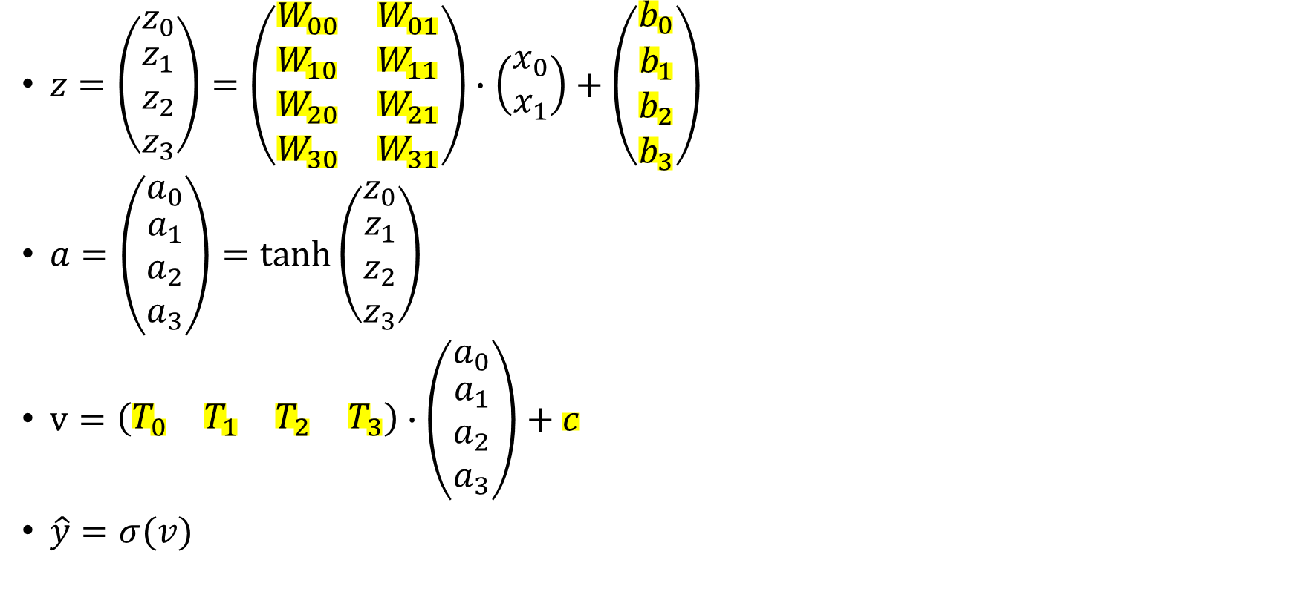
Neural Network forward propagation
$z=\left(\begin{matrix}z_{0} \\ \begin{aligned}z_{1} \\ z_{2} \\ z_{3}\end{aligned}\end{matrix}\right)=\left(\begin{matrix}W_{00} & W_{01} \\ W_{10} & W_{11} \\ \begin{aligned}W_{20} \\ W_{30}\end{aligned} & \begin{aligned}W_{21} \\ W_{31}\end{aligned}\end{matrix}\right)∙\left(\begin{matrix}x_{0} \\ x_{1}\end{matrix}\right)+\left(\begin{matrix}b_{0} \\ \begin{aligned}b_{1} \\ b_{2} \\ b_{3}\end{aligned}\end{matrix}\right)$
$a=\left(\begin{matrix}a_{0} \\ \begin{aligned}a_{1} \\ a_{2} \\ a_{3}\end{aligned}\end{matrix}\right)=\tanh\left(\begin{matrix}z_{0} \\ \begin{aligned}z_{1} \\ z_{2} \\ z_{3}\end{aligned}\end{matrix}\right)$
$v=\left(\begin{matrix}T_{0} & T_{1} & T_{2} & T_{3}\end{matrix}\right)∙\left(\begin{matrix}a_{0} \\ \begin{aligned}a_{1} \\ a_{2} \\ a_{3}\end{aligned}\end{matrix}\right)+c$
$\hat{y}=σ(v)$
FIRST LINEAR LAYER
TANH ACTIVATION FUNCTION
SECOND LINEAR LAYER
PARAMETERS TO LEARN
SIGMOID ACTIVATION FUNCTION

Slide 33
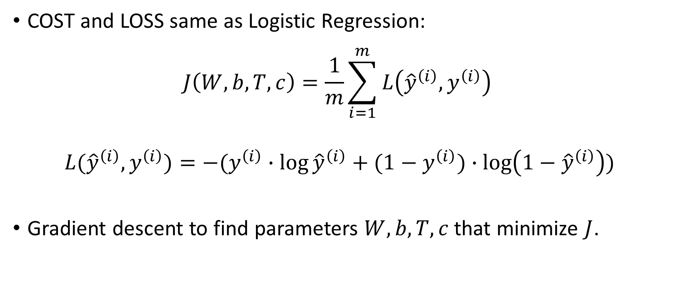
Neural Network: cost and loss
COST and LOSS same as Logistic Regression:
$$J\left(W,b, T, c\right)=\frac{1}{m}\sum_{i=1}^{m}{L\left({\hat{y}}^{\left(i\right)}, y^{\left(i\right)}\right) }$$
$$L({\hat{y}}^{\left(i\right)},y^{\left(i\right)})=−(y^{\left(i\right)}∙\log{{\hat{y}}^{\left(i\right)}}+(1−y^{\left(i\right)})∙\log\left(1−{\hat{y}}^{\left(i\right)}\right))$$
Gradient descent to find parameters $W,b,T,c$ that minimize $J$.

Slide 34


Training Loop
$${ x}_{0}$$
$${ x}_{1}$$

Slide 35





Training Loop
$${ z}_{0}$$
$${ x}_{0}$$
$${ z}_{1}$$
$$W∙x+b$$
$${ x}_{1}$$
$${ z}_{2}$$
$${ z}_{3}$$

Slide 36





Training Loop
$${ z}_{0}$$
$${ a}_{0}$$
$${ x}_{0}$$
$${ z}_{1}$$
$${ a}_{1}$$
$$W∙x+b$$
$$\tanh{z}$$
$${ x}_{1}$$
$${ z}_{2}$$
$${ a}_{2}$$
$${ z}_{3}$$
$${ a}_{3}$$

Slide 37


Training Loop
$${ z}_{0}$$
$${ a}_{0}$$
$${ x}_{0}$$
$${ z}_{1}$$
$${ a}_{1}$$
$$W∙x+b$$
$$\tanh{z}$$
$$T∙a+c$$
$$v$$
$${ x}_{1}$$
$${ z}_{2}$$
$${ a}_{2}$$
$${ z}_{3}$$
$${ a}_{3}$$

Slide 38


Training Loop
$${ z}_{0}$$
$${ a}_{0}$$
$${ x}_{0}$$
$${ z}_{1}$$
$${ a}_{1}$$
$$W∙x+b$$
$$\tanh{z}$$
$$T∙a+c$$
$$σ(v)$$
$$v$$
$$\hat{y}$$
$${ x}_{1}$$
$${ z}_{2}$$
$${ a}_{2}$$
$${ z}_{3}$$
$${ a}_{3}$$

Slide 39
Training Loop
$${ z}_{0}$$
$${ a}_{0}$$
$${ x}_{0}$$
$${ z}_{1}$$
$${ a}_{1}$$
$$W∙x+b$$
$$\tanh{z}$$
$$T∙a+c$$
$$σ(v)$$
$$v$$
$$\hat{y}$$
$${ x}_{1}$$
$${ z}_{2}$$
$${ a}_{2}$$
$${ z}_{3}$$
$${ a}_{3}$$
FORWARD PROPAGATION

Slide 40

Training Loop
$${ z}_{0}$$
$${ a}_{0}$$
$${ x}_{0}$$
$${ z}_{1}$$
$${ a}_{1}$$
$$W∙x+b$$
$$\tanh{z}$$
$$T∙a+c$$
$$σ(v)$$
$$v$$
$$\hat{y}$$
Compute
Cost
$${ x}_{1}$$
$${ z}_{2}$$
$${ a}_{2}$$
$${ z}_{3}$$
$${ a}_{3}$$
$$J$$

Slide 41

Training Loop
$${ z}_{0}$$
$${ a}_{0}$$
$${ x}_{0}$$
$${ z}_{1}$$
$${ a}_{1}$$
$$W∙x+b$$
$$\tanh{z}$$
$$T∙a+c$$
$$σ(v)$$
$$v$$
$$\hat{y}$$
Compute
Cost
$${ x}_{1}$$
$${ z}_{2}$$
$${ a}_{2}$$
$${ z}_{3}$$
$${ a}_{3}$$
$$J$$
$$\frac{∂J}{∂\hat{y}}$$

Slide 42

Training Loop
$${ z}_{0}$$
$${ a}_{0}$$
$${ x}_{0}$$
$${ z}_{1}$$
$${ a}_{1}$$
$$W∙x+b$$
$$\tanh{z}$$
$$T∙a+c$$
$$σ(v)$$
$$v$$
$$\hat{y}$$
Compute
Cost
$${ x}_{1}$$
$${ z}_{2}$$
$${ a}_{2}$$
$${ z}_{3}$$
$${ a}_{3}$$
$$J$$
$$\frac{∂J}{∂v}$$
$$\frac{∂J}{∂\hat{y}}$$

Slide 43



Training Loop
$${ z}_{0}$$
$${ a}_{0}$$
$${ x}_{0}$$
$${ z}_{1}$$
$${ a}_{1}$$
$$W∙x+b$$
$$\tanh{z}$$
$$T∙a+c$$
$$σ(v)$$
$$v$$
$$\hat{y}$$
Compute
Cost
$${ x}_{1}$$
$${ z}_{2}$$
$${ a}_{2}$$
$${ z}_{3}$$
$${ a}_{3}$$
$$J$$
$$\frac{∂J}{∂T_{n}}$$
$$\frac{∂J}{∂a_{n}}$$
$$\frac{∂J}{∂v}$$
$$\frac{∂J}{∂\hat{y}}$$
$$\frac{∂J}{∂c}$$

Slide 44

Training Loop
$${ z}_{0}$$
$${ a}_{0}$$
$${ x}_{0}$$
$${ z}_{1}$$
$${ a}_{1}$$
$$W∙x+b$$
$$\tanh{z}$$
$$T∙a+c$$
$$σ(v)$$
$$v$$
$$\hat{y}$$
Compute
Cost
$${ x}_{1}$$
$${ z}_{2}$$
$${ a}_{2}$$
$${ z}_{3}$$
$${ a}_{3}$$
$$J$$
$$\frac{∂J}{∂T_{n}}$$
$$\frac{∂J}{∂z_{n}}$$
$$\frac{∂J}{∂a_{n}}$$
$$\frac{∂J}{∂v}$$
$$\frac{∂J}{∂\hat{y}}$$
$$\frac{∂J}{∂c}$$

Slide 45

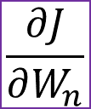
Training Loop
$${ z}_{0}$$
$${ a}_{0}$$
$${ x}_{0}$$
$${ z}_{1}$$
$${ a}_{1}$$
$$W∙x+b$$
$$\tanh{z}$$
$$T∙a+c$$
$$σ(v)$$
$$v$$
$$\hat{y}$$
Compute
Cost
$${ x}_{1}$$
$${ z}_{2}$$
$${ a}_{2}$$
$${ z}_{3}$$
$${ a}_{3}$$
$$J$$
$$\frac{∂J}{∂W_{n}}$$
$$\frac{∂J}{∂T_{n}}$$
$$\frac{∂J}{∂z_{n}}$$
$$\frac{∂J}{∂a_{n}}$$
$$\frac{∂J}{∂v}$$
$$\frac{∂J}{∂\hat{y}}$$
$$\frac{∂J}{∂b_{n}}$$
$$\frac{∂J}{∂c}$$

Slide 46
Training Loop
BACKWARD PROPAGATION
$$J$$
$$\frac{∂J}{∂W_{n}}$$
$$\frac{∂J}{∂T_{n}}$$
$$\frac{∂J}{∂z_{n}}$$
$$\frac{∂J}{∂a_{n}}$$
$$\frac{∂J}{∂v}$$
$$\frac{∂J}{∂\hat{y}}$$
$$\frac{∂J}{∂b_{n}}$$
$$\frac{∂J}{∂c}$$

Slide 47
Training Loop
$${ z}_{0}$$
$${ a}_{0}$$
$${ x}_{0}$$
$${ z}_{1}$$
$${ a}_{1}$$
$$W∙x+b$$
$$\tanh{z}$$
$$T∙a+c$$
$$σ(v)$$
$$v$$
$$\hat{y}$$
Compute
Cost
$${ x}_{1}$$
$${ z}_{2}$$
$${ a}_{2}$$
$${ z}_{3}$$
$${ a}_{3}$$
$$J$$
$$\frac{∂J}{∂W_{n}}$$
$$\frac{∂J}{∂T_{n}}$$
$$\frac{∂J}{∂z_{n}}$$
$$\frac{∂J}{∂a_{n}}$$
$$\frac{∂J}{∂v}$$
$$\frac{∂J}{∂\hat{y}}$$
$$\frac{∂J}{∂b_{n}}$$
$$\frac{∂J}{∂c}$$

Slide 48

Training Loop
$${ z}_{0}$$
$${ a}_{0}$$
$${ x}_{0}$$
$${ z}_{1}$$
$${ a}_{1}$$
$$W∙x+b$$
$$\tanh{z}$$
$$T∙a+c$$
$$σ(v)$$
$$v$$
$$\hat{y}$$
Compute
Cost
$${ x}_{1}$$
$${ z}_{2}$$
$${ a}_{2}$$
$${ z}_{3}$$
$${ a}_{3}$$
$c=c−α$ $\frac{∂J}{∂c}$
$$J$$
$$\frac{∂J}{∂W_{n}}$$
$$\frac{∂J}{∂T_{n}}$$
Update
Parameters
$$\frac{∂J}{∂z_{n}}$$
$$\frac{∂J}{∂a_{n}}$$
$$\frac{∂J}{∂v}$$
$$\frac{∂J}{∂\hat{y}}$$
$$\frac{∂J}{∂b_{n}}$$
$$\frac{∂J}{∂c}$$

Slide 49
Training Loop
$${ z}_{0}$$
$${ a}_{0}$$
$${ x}_{0}$$
$${ z}_{1}$$
$${ a}_{1}$$
$$W∙x+b$$
$$\tanh{z}$$
$$T∙a+c$$
$$σ(v)$$
$$v$$
$$\hat{y}$$
Compute
Cost
$${ x}_{1}$$
$${ z}_{2}$$
$${ a}_{2}$$
$${ z}_{3}$$
$${ a}_{3}$$
$c=c−α$ $\frac{∂J}{∂c}$
$$J$$
$$\frac{∂J}{∂W_{n}}$$
$$\frac{∂J}{∂T_{n}}$$
Update
Parameters
$$\frac{∂J}{∂z_{n}}$$
$$\frac{∂J}{∂a_{n}}$$
$$\frac{∂J}{∂v}$$
$$\frac{∂J}{∂\hat{y}}$$
$$\frac{∂J}{∂b_{n}}$$
$$\frac{∂J}{∂c}$$

